Slide 1

Costs of job loss: Wage scarring
Elyse Dwyer, Gianni La Cava, and Matt Nolan
Monash Seminar – 21-May-2024

Slide 2
Outline
Goal: Provide estimates of the dynamic wage loss associated with job loss (wage scarring).
Motivation: Understanding the spillover on future earnings from job loss, and how it varies over the cycle, is important to policy makers – and helps us understand more about the cost of job loss of those displaced.
Approach: Use an event study approach comparing long-tenure workers who leave their job in a mass layoff to those who remain in with their firm.
Findings: Average initial scar of 17%, wage scar persists (8% after 5 years).
Industry effects: Larger scarring in primary industries.
Scar by prior earnings: Highest and lowest income groups experience proportionally larger scars.
Age: Wage scarring is similar by age group.
Next steps – extending outcomes and understanding mechanisms (decomposing wage scars)

Slide 3
What is wage scarring?
A reduction in wage income due to the loss of a job.
Want to compare the wage earnings of an individual who experiences job loss
to themselves if they did not experience job loss.
Reflects the financial cost of job loss to the individual:
Not the full individual cost: i.e. mental health costs.
Not the full productivity effect: i.e. “transfer” of surplus to firm or another worker.
Not the full social effect: i.e. spillovers on family violence.
However, quantifying this and understanding the mechanisms can inform these broader questions.

Slide 4
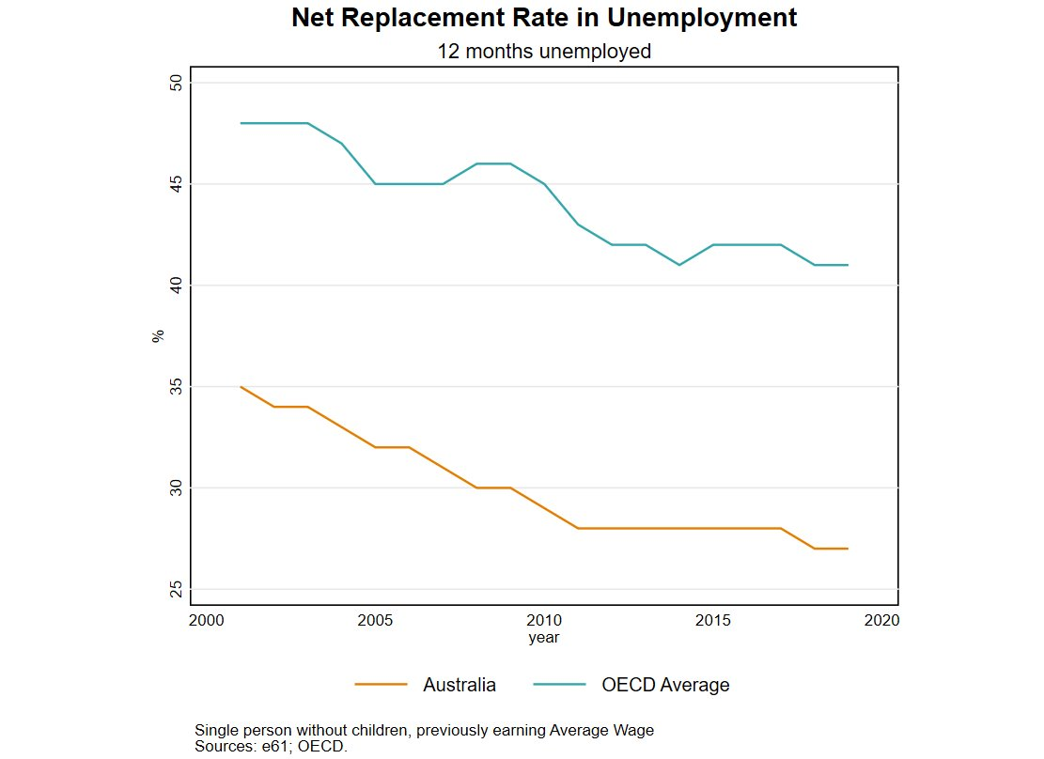
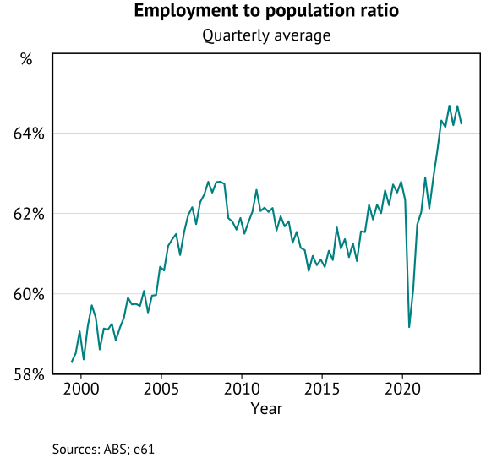
Why look at wage scarring now?
Implications for benefit system reform:
Does the lack of “income insurance” lead to wage scars
would expect higher scarring for high wage earners.
Does targeting force individuals to take on lower incomes
would expect lower scarring for benefit recipients.
would expect higher scarring for low wage earners.
Implications for cyclical policy:
Does scarring increase over the economic cycle?
Is cyclical scarring driven by difficulty finding work?

Slide 5
What is the ideal experiment
A government researcher determines, at random, that 1 percent of individuals have their employment
match severed. The same researcher removes any knowledge the firm had about prior workers – so they
have to rehire anonymously.
Nature closes a fraction of all firms at random, forcing the workers at those firms to look for new work.
In both cases, random assignment into job loss ensures that we can compare outcomes of those who lose
their job to those who don’t to understand the causal effect of job loss.
Our outcome of interest today is labour market earnings in all jobs.

Slide 6
What is our approach
In the data we do not observe a truly exogenous job separation. We observe individuals who have left their job with an employer. As a result, there are potential choices made by employers and employees that may
bias our estimates.
Worker based selection: A worker with greater outside options may opt-out of work (Mortensen and Pissarides 1994).
Firm based selection: A firm may remove a worker they view as a low “type” (Gibbons and Katz 1991).
We attempt to mitigate concerns about selection by considering the end of long-tenure employment during a mass layoff by the firm.
Mass layoff: By losing a large number workers the firm and workers are more likely
to be facing an external shock.
Long-tenure: Firms and workers know each others type after time together – and remained together.
Minimum earnings: By imposing a minimum prior earnings we look at genuine attachments.
Another way to understand this idea of exogenous separation, is “as good as random treatment timing”
of job loss.
Consider anticipation effects to understand if this is appropriate.
However, underlying concern about different influences cancelling out.

Slide 7
Comparison to other literature
Australia
RBA studies
International
Lancaster (2021) – HILDA job loss, 30% initial scar, 0% 5 year.
Coates and Ballantyne (2022) – HILDA job loss, 26% initial scar, 18% 5 year.
Hambur and Nolan (forthcoming) – PLIDA.
US: Jacobsen et al (1993), Lachowska (2020)
Germany: Schmieder et al (2022), Woodcock (2023)
Other Europe: Bertheau et al (2023), IFS (2023)
New Zealand: Hyslop & Townsend (2019)
e61 work.
Hayward et al (forthcoming) – compares voluntary and involuntary job loss.
Clarke et al 2023 – 5% consumption scar from job loss.
Dwyer et al 2023 – genuine redundancy, 43% scar, 29% 4 year.
Hoefer Marti et al 2023 – mass layoffs, 27% scar, 16% 5 year.
Table of scarring results
Australia
Other/related
Persistence of earning shocks: Tin & Tran (2023)
Early career scarring: Andrews et al (2020)
MI Barriers reports: Ananyev et al (2023)

Slide 8
Data and sample construction

Slide 9
Description of the LEED
Links PLIDA and BLADE data to generate a linked-employer-employee database.
Dataset constructed for the 2002-2021 period.
Firms represented at the business group level (where possible).
Industry classifications also based on firm reporting.
Worker earnings per job based on PAYG data – with a small amount of imputation using the PIT data.
Benefit status incorporated using DOMINO data.
Individual age, if they have died, and broad location (state) from the combined information files.
Individual dropped when:
The individual has a job that is in the top 1% of PAYG wage earners in a given Financial Year.
Individuals date of birth or date of death were implausible.
Income set to zero when missing, unless identified as dead.
Analysis using 20% random sample of individuals (should be able to extend to a larger sample soon).

Slide 10
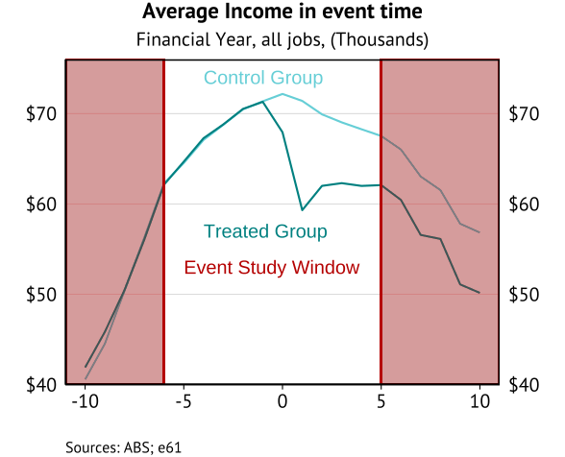
Outcome of group assignment
In the coming slides we will outline how the treatment and control groups are assigned.

Slide 11
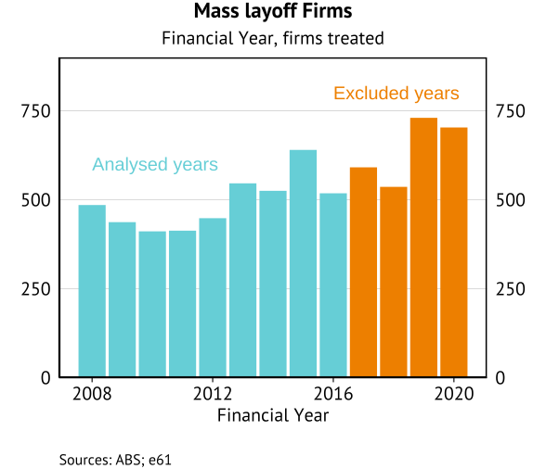
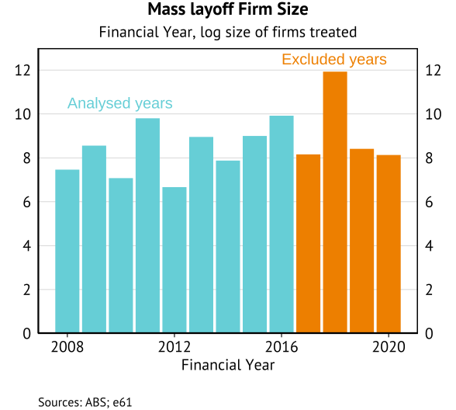
Assignment to treatment – treated firms
Conditions
Firm size must be at least 20 in the year before the event (based on observed employee data).
In operation for at least six years.
No industry exclusions at this stage (prior mass layoff work showed larger scars for private sector work)

Slide 12
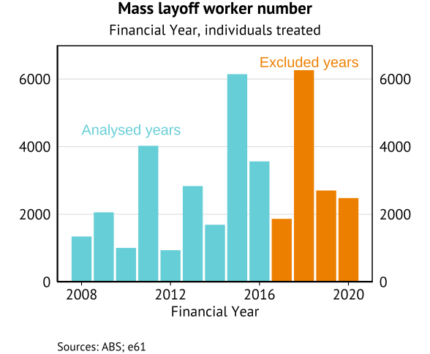
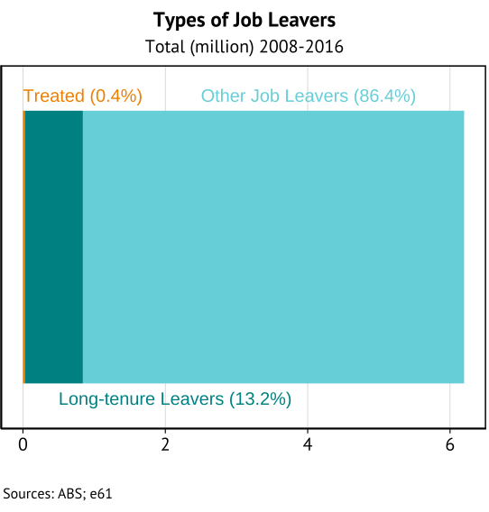
Assignment to treatment – treated individuals
Conditions
Employed at a treated firm for at least five years (in sixth year of employment).
Aged between 25 and 54 at treatment.
Real earnings in excess of $20k in each of the five prior years.
Remains treated after first treatment.
Shorter tenure and no prior earnings limit.
Small numbers, but reasonable relative to international studies.
Study comparisons
Notes:
15% of all job separations are long tenure
0.44% of all job separations are part of “treatment” for what we are considering.

Slide 13
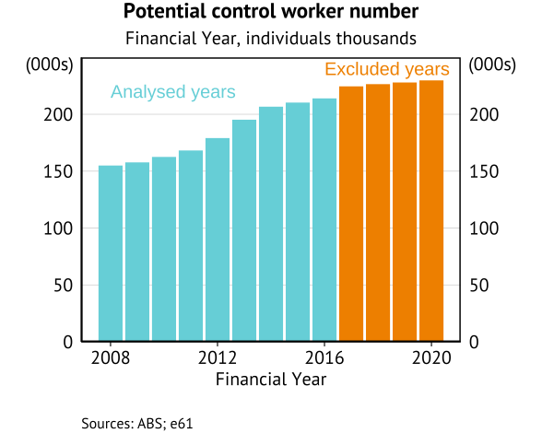
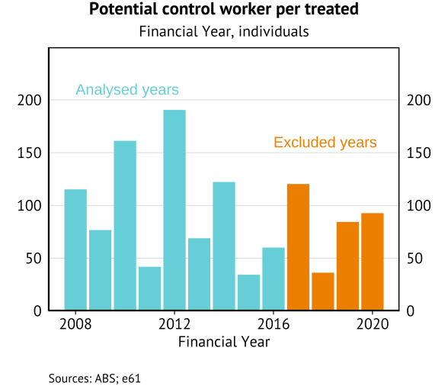
Potential control units
Potential control group: All “long tenure” workers who did not lose their job in a mass layoff.
Schmieder et al (2022) and Bertheau et al (2023): Use this control group, but individuals
could lose their job – just not in a mass layoff.
Lachowska (2022): Control group reflects individuals who are ALWAYS employed by the same firm.
Our potential controls: Individuals who are at least in their sixth year of employment with this firm,
are not treated now or previously, and remain employed with this firm in the following year.

Slide 14
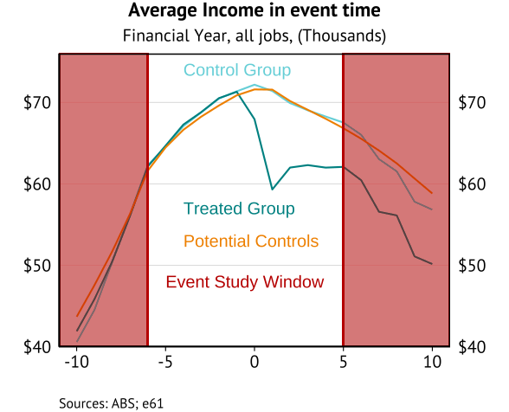
Matching and assigned control units
The treatment and potential controls differ on unobservables.
Question of how we should control for lack of balance.
Abadie (2005) PSM to create a control group.
C’SA (2020) reweight potential controls to look similar to the treatment group (IPTW).
We instead select control units for comparison based on a distance matching approach.
PSM and random matching results
Match on industry partition - based on a distance measure using age, tenure, gender, and prior income two and three years earlier (not all, or an average of, prior incomes).
Literature uses greedy nearest neighbourhood matching (PSM). However, although the balance of averages is very good using this approach – the variance is very different. Income distribution for the two groups is very different as a result. We use mahalanobis distances to account for this (alternatives: stratification PSM, CEM).
Notes:
Initially Ran greedy NN as used in literature (relies on propensity scores). Ran CEM – dropped nearly 3/4ths of the treated units for not having control units that were close enough. Indicated that a caliper method that allows us to investigate the drops further would be good.
Use a more iterative NN method with “genetic” matching. This is very slow even for a single year. So have dropped.
Instead relied on mahalanobis matching to penalise distance (King and Neilsen 2019).

Slide 15
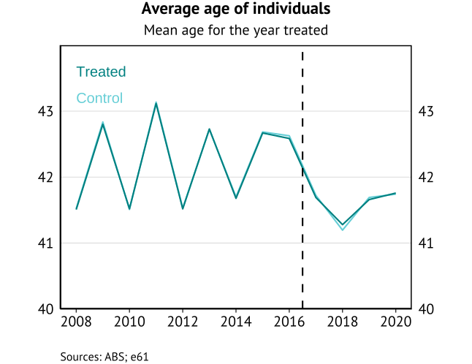
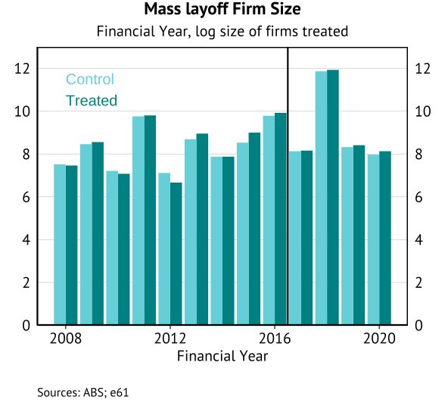
Age and firm size information
Balance by industry is perfect by definition. But for age and firm size we need to compare treated and control groups.
Notes:
Relative to unmatched:
Income is lower,
Age is similar
Industry is more weighted towards services in the unmatched
Tenure is

Slide 16
Method

Slide 17
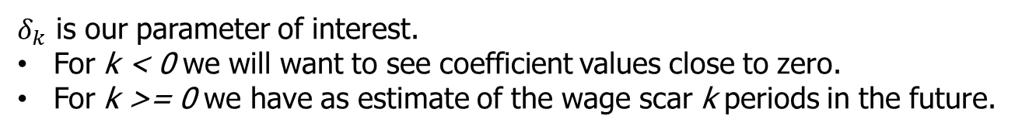
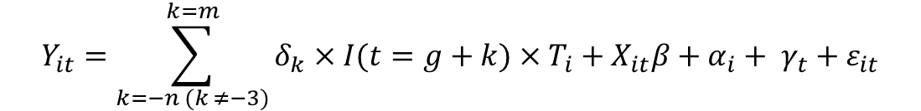
Event study approach and gTTEs
For those treated in a specific year (a cohort, or group) we can estimate their wage scar by comparing their
earnings profile to our selected control group. Taking the treated and selected control units in a given year (g)
we estimate the following dynamic event study model.
$$Y_{it}=\sum_{k=−n (k ≠−3)}^{k=m}{δ_{k}×I(t=g+k)}×T_{i}+X_{it}β+α_{i}+ γ_{t}+ε_{it}$$
Here an individual's wage income in a given year is a function of time varying observable characteristics, time invariant characteristics, calendar time effects, and an idiosyncratic error term.
$δ_{k}$ is our parameter of interest.
For k < 0 we will want to see coefficient values close to zero.
For k >= 0 we have as estimate of the wage scar k periods in the future.
Same approach used in Hoefer Marti et al (2023) for 2009FY. However, we can now show how these results vary by year (between 2008FY and 2020FY).

Slide 18
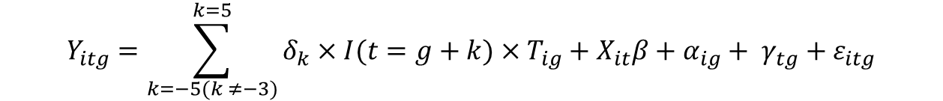
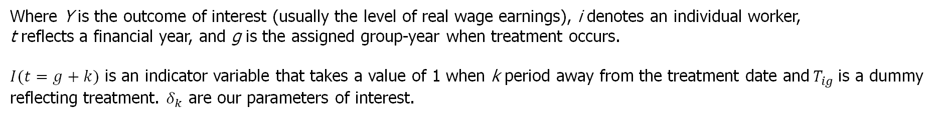
Stacked regression
Each gTTE is a sub-experiment. Denoting these as specific groups, we want to estimate a model that reveals the
ATT from these sub-experiments.
Can estimate the model in one step via pooled OLS on the “stacked” dataset of treated and control units.
$$Y_{itg}=\sum_{k=−5(k ≠−3)}^{k=5}{δ_{k}×I(t=g+k)×T_{ig}}+X_{it}β+α_{ig}+ γ_{tg}+ε_{itg}$$
Where Y is the outcome of interest (usually the level of real wage earnings), i denotes an individual worker,
t reflects a financial year, and g is the assigned group-year when treatment occurs.
$I(t=g+k)$ is an indicator variable that takes a value of 1 when k period away from the treatment date and$T_{ig}$is a dummy reflecting treatment. $δ_{k}$ are our parameters of interest.
Identifying assumptions
Individual and time fixed effects (interacted by group). Controls are age squared and age interacted with gender.
To ensure all years are contributing to the full set of estimates (all treated units have the same overall exposure), this reflects estimated scaring between 2008 and 2016.
Flaw: Implied weighting of sub-experiments still based on OLS weights, may be inappropriate.
But results are comparable when we aggregate the gTTEs based on cohort size (Sun and Abraham 2021).
Notes:
Following Bacon etal (2021) we adjust this from a standard event study model in terms of the unit and time
fixed effects being saturated by group membership – i.e. the unit effect can differ when an individual is in a
different groups.
In this instance, the results are unaffected by this assumption (with the inclusion of event time dummies).
Furthermore, in other wage scarring studies the event time is also controlled for in the regression to deal with “hump shaped” incomes near the event. However, if we follow a stacked approach and saturate our time FEs this control is collinear with this control.

Slide 19
Results

Slide 20
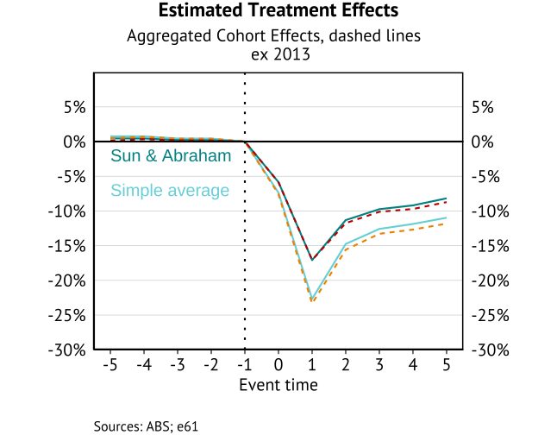
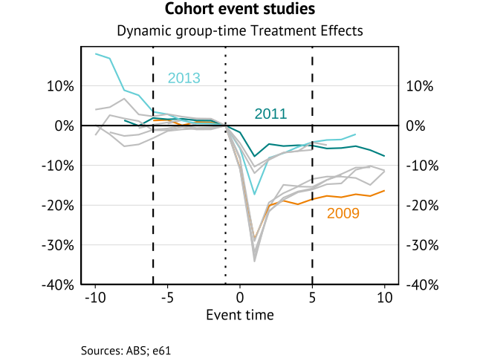
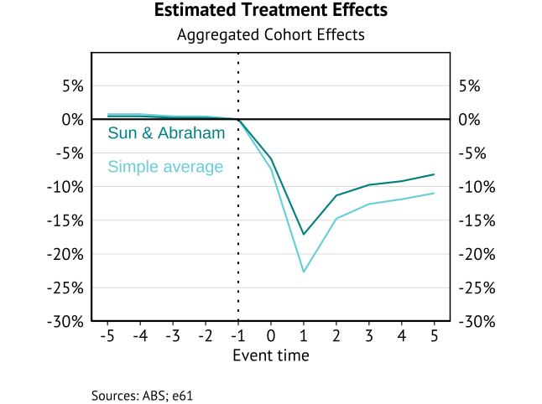
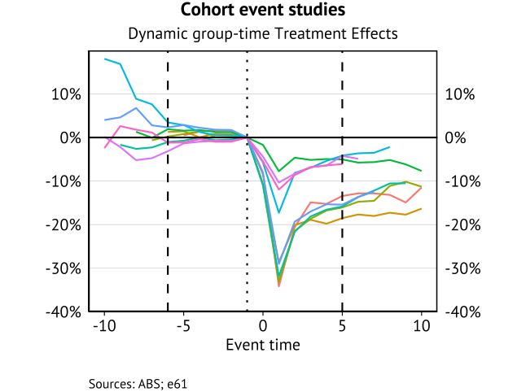
Group-time treatment effects – wage scars
Dollar terms
Random matching

Slide 21
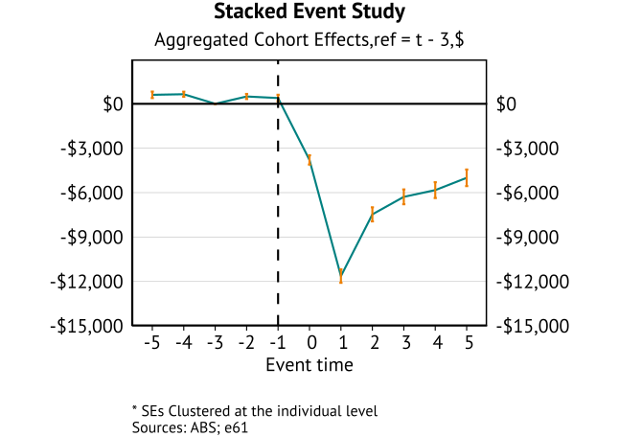
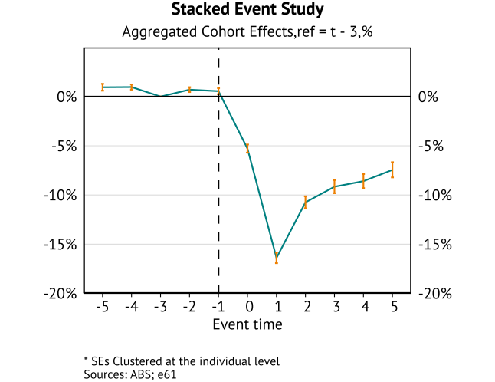
Stacked estimator – wage scars
Sensitivity
Tenure
Prior earnings
PSM/Random matching

Slide 22
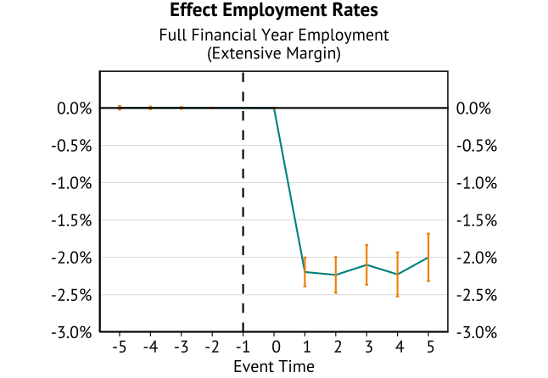
Employment probabilities
Want to understand the role of higher non-employment probabilities for the treated group. Repeat same event
study specification with employment status dummy as the outcome variable.

Slide 23
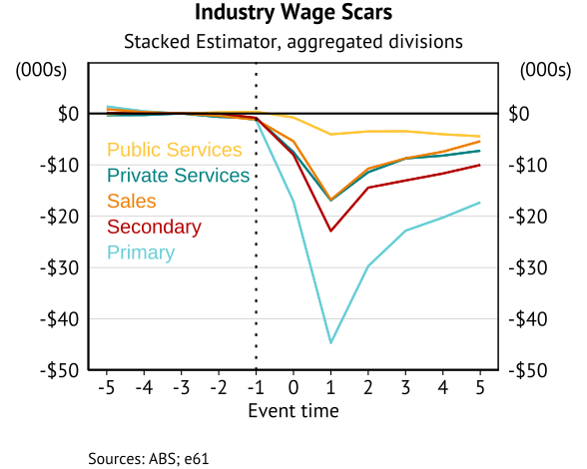
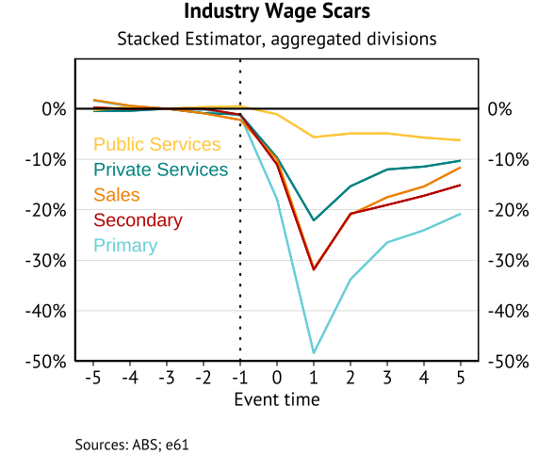
Heterogeneity – Industry results
At this stage we only have high level industry results
Industry summary stats
Primary industries (agriculture, mining) have a larger scars (as in Dwyer et al (2023) and IFS (2023)).
However, the trajectory by broad industry is similar.

Slide 24
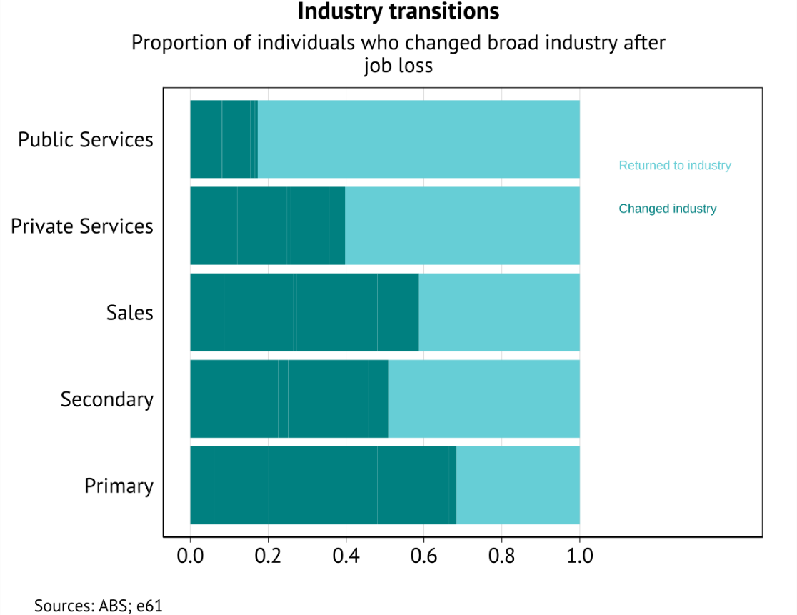
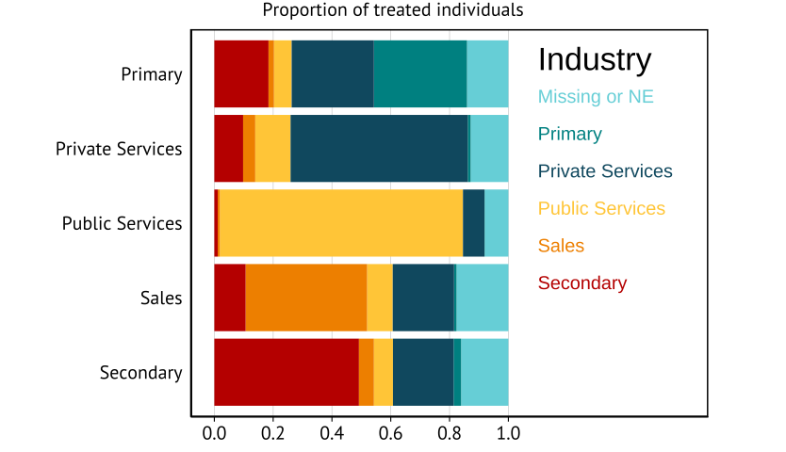
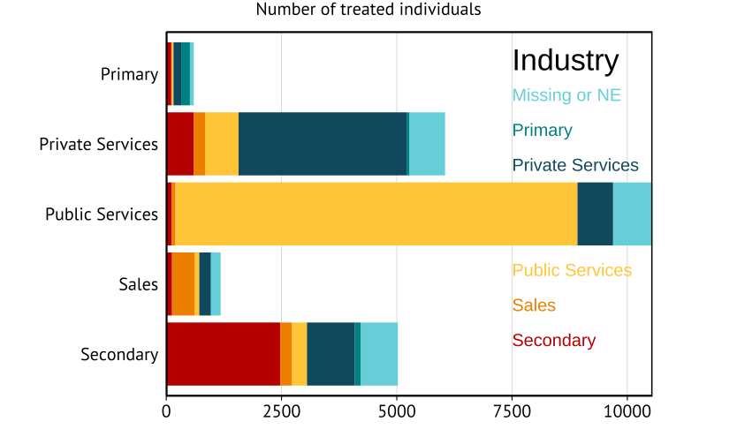
Heterogeneity – Industry mobility
Y-axis reflects industry prior to mass layoff, colour represents transition 5 years later.
Employment shares similar across industry groups (except primary which is much lower).
Long-tenure assumptions limit treated number from sales, expand numbers from public service
Larger scaring occurs in sectors where more individuals transition to another sector.

Slide 25
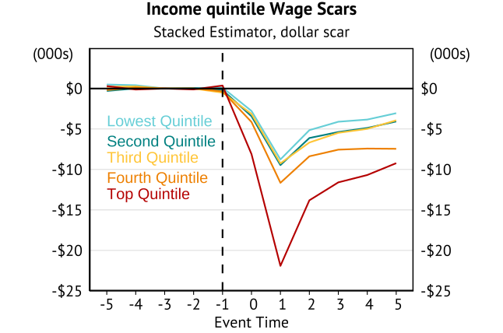
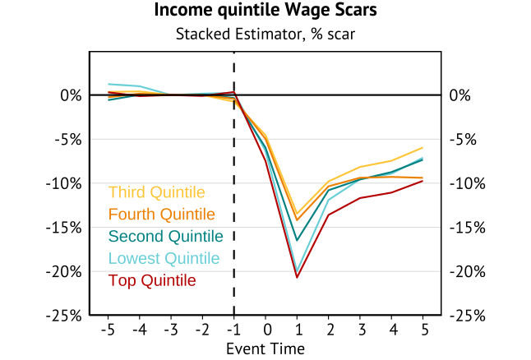
Heterogeneity – Income bins
Top and bottom quantile experiences the largest proportional scarring.
Incomes by quantile summary stats
Differs from US results of similar distributional scarring (Rose & Shem-Tov 2023).

Slide 26
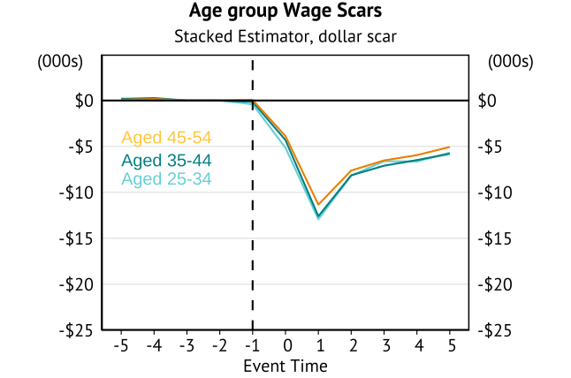
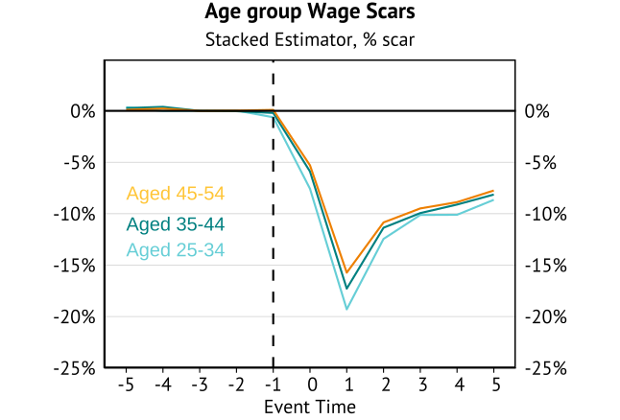
Heterogeneity – Age bins
Wage scarring (in levels) very similar by age bin. Proportionally larger for younger individuals.
Unreleased work by Treasury/RBA suggested persistent scarring was only an issue for those
excluded from our analysis (55+). Early retirement shows up in “10-year scars” based on subset of years.
Age summary stats

Slide 27
Conclusion

Slide 28
Conclusion
Key finding: Initial wage scarring of 17%, falling to 8% after five years. In line with international studies.
Other results
Industry matters – primary industries especially show much larger scarring.
Prior income matters – low- and high-income individuals experience larger scarring.
Age surprisingly unimportant (conditional on long-tenure).
Intended next steps (in order)
Produce a battery of robustness checks: i.e. Randomise treatment, other samples.
Look at other outcomes: Cumulative income loss, longer-term benefit receipt, probability of future job moves, family formation and fertility.
Extend heterogeneity: Gender, re-employment timing, occupation, industry transitions.
Decomposition of these scars: AKM with match effects (Woodcock 2023).
Control groups: Only individuals from the same firms. K:1 matching. All potential controls.
Sensitivity to alternative forms of treatment: Additional work with redundancy. Removing identified job-to-job transitions. “Expected firm closure”.

Slide 29
Appendix

Slide 30
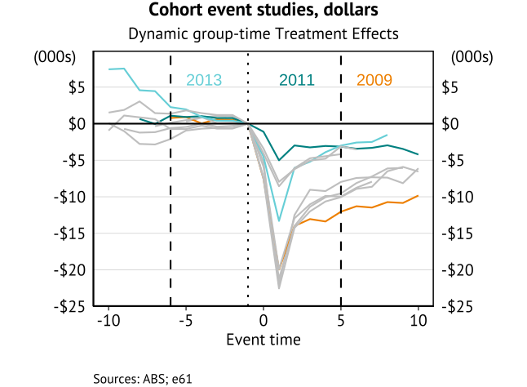
Appendix A: Year-by-year dollar scars

Slide 31
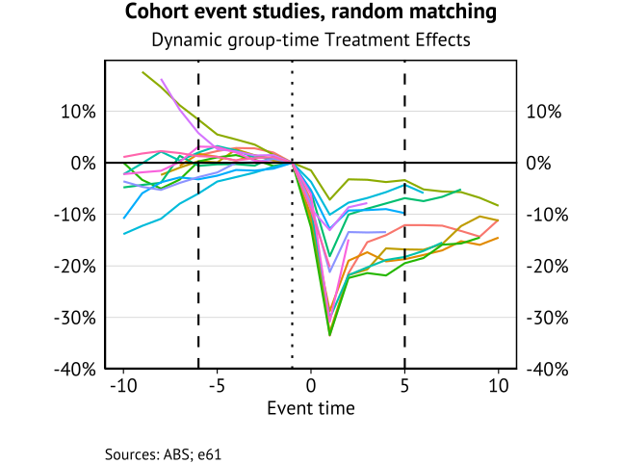
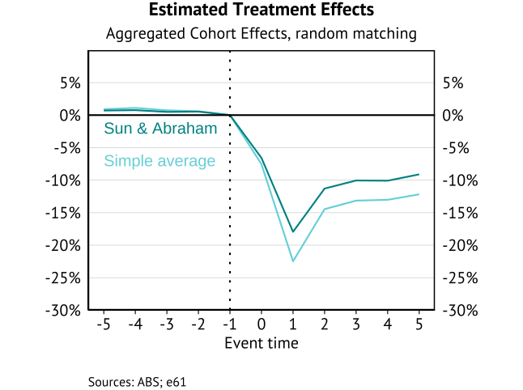
Appendix B: Year-by-year random matching
Concern is that matching will exaggerate the wage scar due to reversion to the mean. To evaluate can look at
randomly selected control units. We find:
Pre-trends (of varying types) across a number of years due to imbalance.
Scarring estimates are slightly higher using random matching.

Slide 32
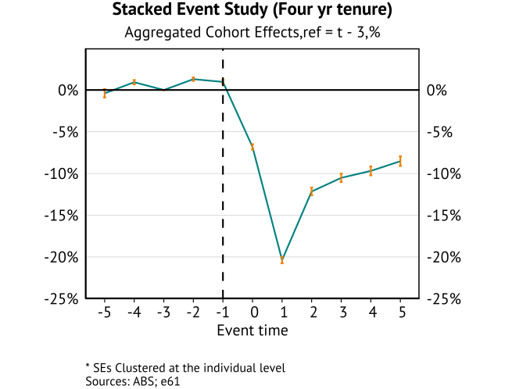
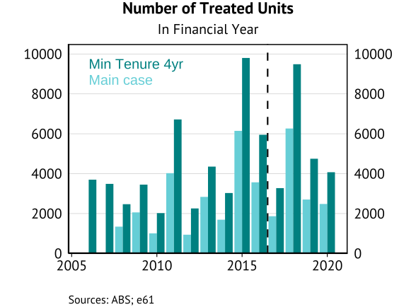
Appendix C: Four-year tenure results

Slide 33
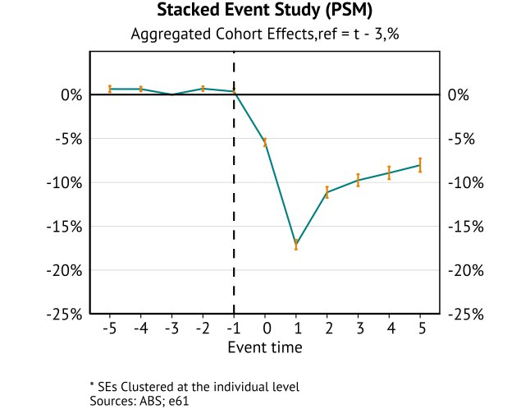
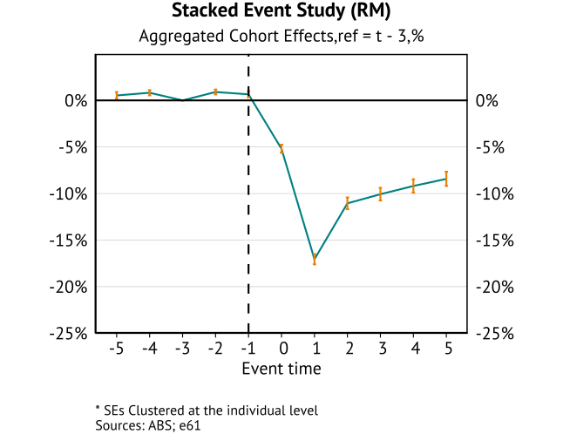
Appendix D: PSM and random matching results

Slide 34
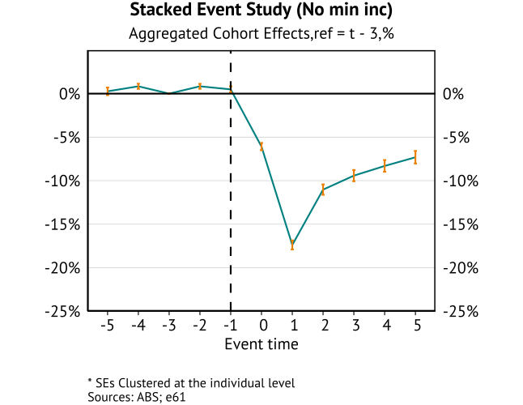
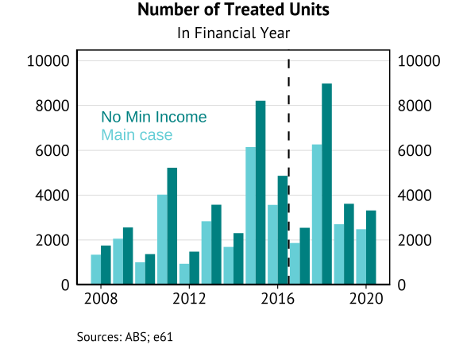
Appendix E: No minimum pre-earnings results

Slide 35
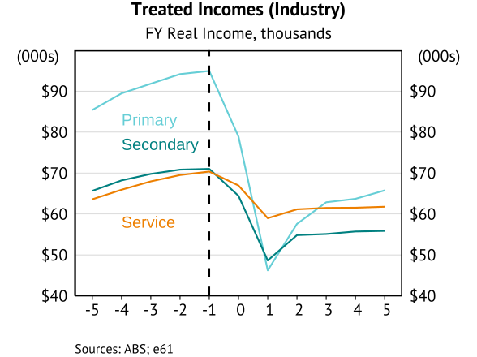
Appendix F: Industry information
Industry definitions (using 2006 classification): Primary = (A,B), Secondary = (C,D,E,F), Service = G onwards
Future results will significantly fewer missing due to updated linkages.
Service income breakdown to be added, alongside treated and control counts.

Slide 36
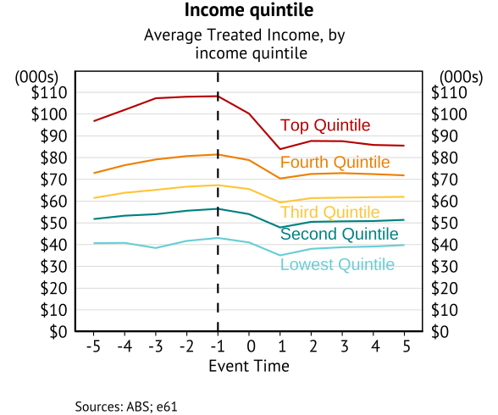
Appendix G: Income bins information
Quintile defined by treated unit position in annual income distribution at (t-3).
The control units are a “matched pair” with this individual – so their position could differ.
Will clear the control incomes in the future to show average similarity (was removed from this request).
Illustrates the importance of different matching assumptions to define the pair.

Slide 37
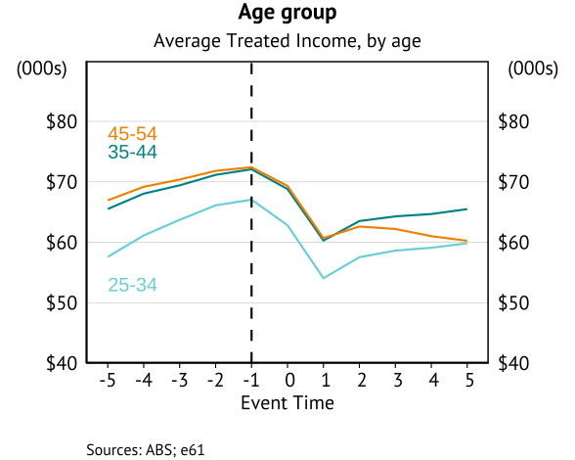
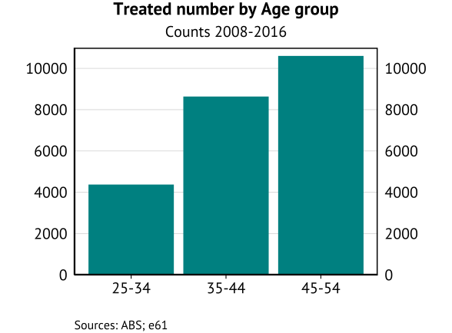
Appendix H: Age information

Slide 38
Appendix I: Count of observations across international studies
Lachowska et al 2020 – 2,690 treated individuals in 2008-2010.
Bertheau et al 2023:
Average of 1,100 treated individuals per year (Spain) to 6,800 individuals per year (Portugal).
Large range of samples used, from 4% in Spain to 100% in Portugal.
Relative to this study we have a much shorter time horizon – with between 13 (Spain) and 35 (Denmark) years in scope.
Schmieder et al (2022) – average of 2,700 treated individuals per year (over 35 years).

Slide 39
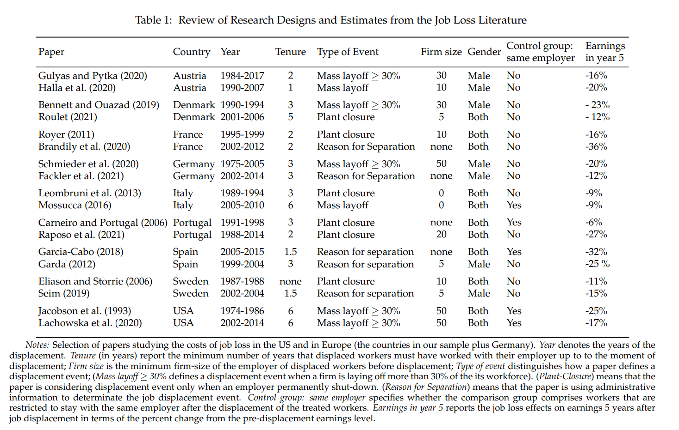
Appendix J: Result comparison across international studies
Bertheau et al 2023 table
Hyslop & Townsend:
Reason for separation (survey)
Use involuntary job loss
Conditional on employment
25-30% initial scar
13-22% five-year scar
Method:
1 year tenure.
PSM, K:1 (up to 10)

Slide 40
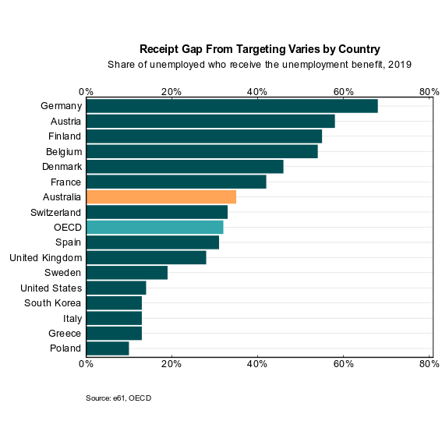
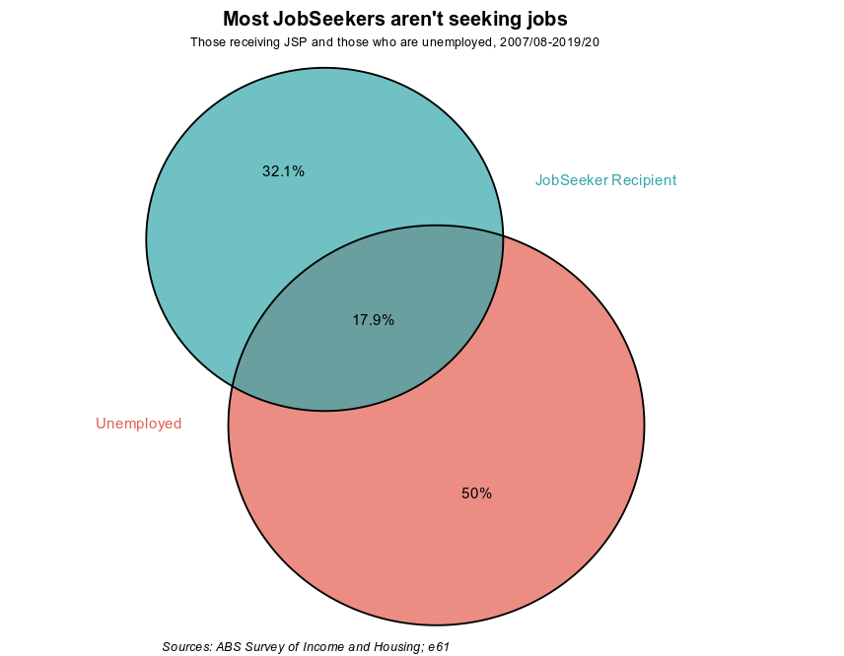
Appendix K: Result comparison across international studies

Slide 41
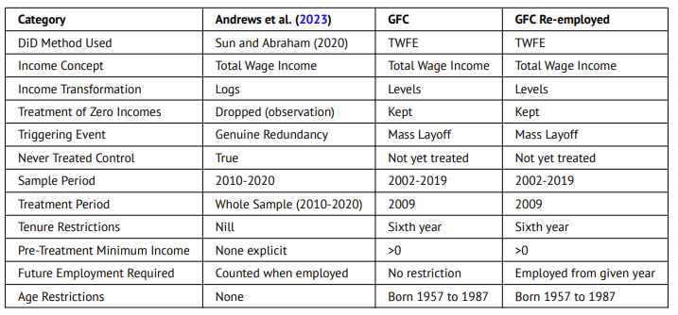
Appendix L: Comparison of prior e61 work (assumptions)

Slide 42
Appendix M: Explicit Identifying assumptions
Base event study
No anticipation/as good as random treatment timing
(conditional) parallel trends
SUTVA
To judge this we can:
Vary the pre-incomes periods/length used for matching for sensitivity.
Looked at balance in pre-treatment incomes for a long-time horizon (up to 7 years prior to matching).
With matching we are also relying on pre-period outcomes (i.e. income at t-1) being unrelated to
the probability of treatment (regression to the mean).
Receiving an earnings premium in earlier years due to the risk of firm failure or restructuring.
Suffering an earnings growth penalty in earlier years due to firm difficulties.
i.e. if treatment did not occur in the period, these effects would “reverse out” in any case.
To support this we:
Look at longer horizon prior income for matching.
Look at results with random matching (where this bias will not hold).
Notes:
Following Bacon etal (2021) we adjust this from a standard event study model in terms of the unit and time
fixed effects being saturated by group membership – i.e. the unit effect can differ when an individual is in a
different groups.
In this instance, the results are unaffected by this assumption (with the inclusion of event time dummies).
Furthermore, in other wage scarring studies the event time is also controlled for in the regression to deal with “hump shaped” incomes near the event. However, if we follow a stacked approach and saturate our time FEs this control is collinear with this control.

Slide 43
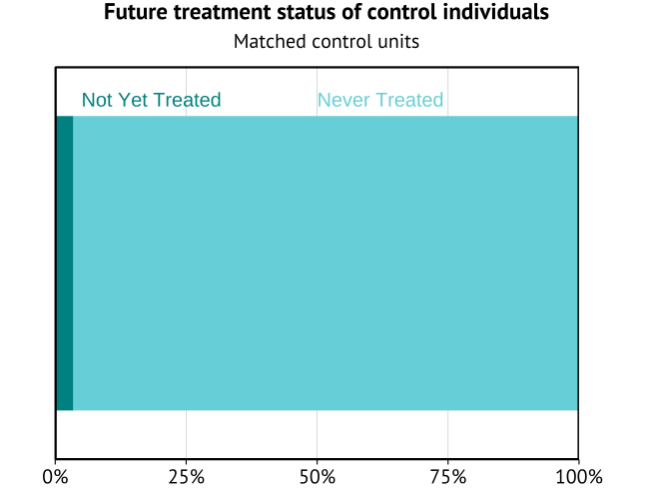

Appendix N: Additional details
Reminder: Benefit-unemployment overlap

Slide 44




Appendix O: Results from related e61 work
Hayward et al
(forthcoming)
Hoefer Marti et al (2023)
Dwyer et al (2023)
Clarke et al (2023)
Mass Layoff (FY09)
Redundancy (2010-20)
Job loss (2006-2019)
Job loss (2002-2019)
TWFE (not staggered)
Sun Abraham
Sun Abraham
Callaway Santa-Anna

Slide 45


Appendix P: Heterogeneity – Benefit receipt
In prior e61 work, consumption scarring was larger for benefit recipients.
Wage scarring significantly larger (relative to prior income) for 8-10% of treated group receiving the benefit.
Likely selection (greater take-up by those who expect it harder to return to work).

Slide 46

Appendix Q: Cyclicality of wage scars
To initially describe the potential cyclicality of the wage scar we follow the approach of Schmieder et al (2022).
Simple regression of t +1 wage scar on the change in the UR. Shows that a one pp increase in the UR is associated with $2,400 greater initial scarring (2011/12) – and has a greater effect on younger workers.
Can more precisely look into cyclical effects after estimating an AKM model of wage determination, and
using the worker and establishment (pre-mass layoff) effects as controls.

